Slide 1
Return a Value from a Function
ELEC1006: ENGINEERING COMPUTING

Slide 2

The return Statement
Used to end execution of a function.
Can be placed anywhere in a function.
Can be used to prevent abnormal termination of program (see Example 2).
In a void function, where there is no return statement, the function ends at its last }.
PAGE 2

Slide 3
1) Returning a Value from a Function
In a value-returning function, the return statement can be used to return a value from function to the point of call. Example:
int sum(int num1, int num2) { double result; result = num1 + num2; return result; }
Return Type
Value Being Returned
PAGE 3

Slide 4
2) Returning a Value from a Function
int sum(int num1, int num2) { return num1 + num2; }
Functions can return the values of expressions, such as num1 + num2
PAGE 4

Slide 5
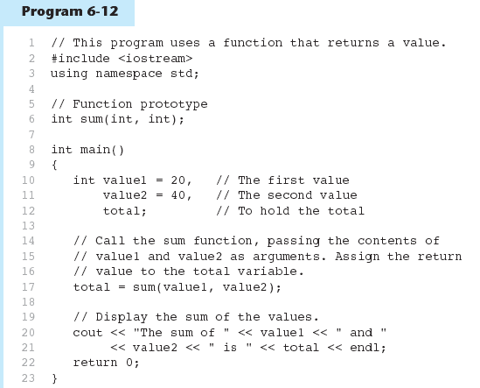
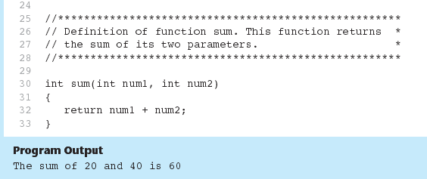
Example 1
PAGE 5

Slide 6
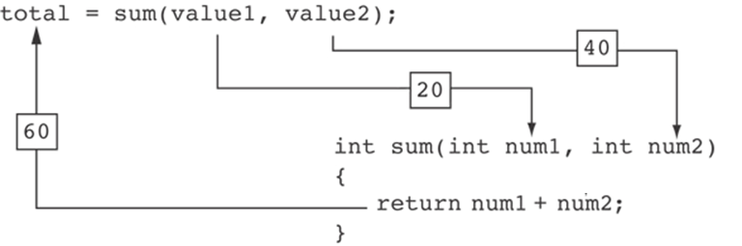
Example 1 continued …
The statement in line 17 calls the sum function, passing value1 and value2 as arguments. The return value is assigned to the total variable.
PAGE 6

Slide 7
3) Returning a Value from a Function
The prototype and the definition must indicate the data type of return value (not void).
Calling function should use return value:
assign it to a variable.
send it to cout.
use it in an expression.
Statements that follow the return statement will not be executed. See Example 2.
PAGE 7

Slide 8
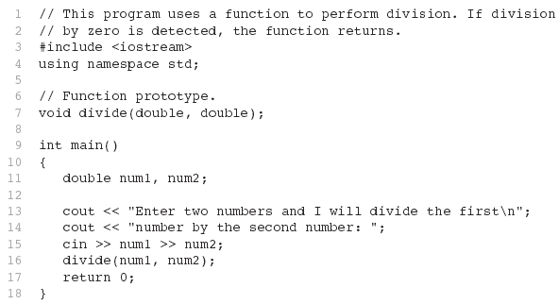
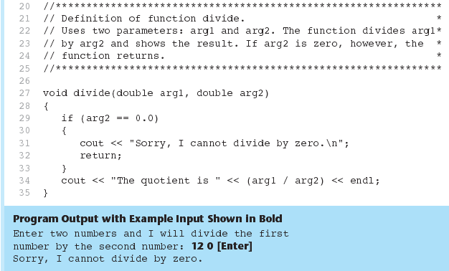
Example 2
PAGE 8

Slide 9
Returning a Boolean Value
Function can return true or false
Declare return type in function prototype and heading as bool
Function body must contain return statement(s) that return true or false
Calling function can use return value in a relational expression
PAGE 9

Slide 10
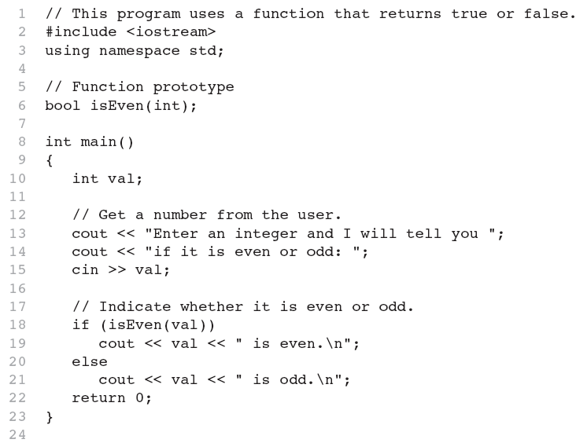
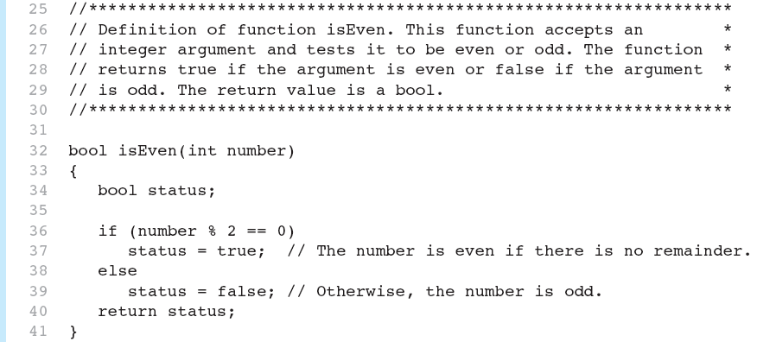

Example 3
PAGE 10

Slide 11
More info
[1] cplusplus.com: Functions
https://cplusplus.com/doc/tutorial/functions/
[2] learncpp.com: 2.2 – Function return values
https://www.learncpp.com/cpp-tutorial/function-return- values/
PAGE 11

